Slide 1
Database System Implementation CSE 507
Indexing Structures
Some slides adapted from R. Elmasri and S. Navathe, Fundamentals of Database Systems, Sixth Edition, Pearson.
And Silberschatz, Korth and Sudarshan Database System Concepts – 6th Edition.

Slide 2
Indexes as Access Paths
The index is usually specified on one field of the file (although it could be specified on several fields)
One form of an index is a file of entries <indexing field value, pointer to record>, which is ordered by field value
The index is called an access path on the field.
The index file is always ordered on the “indexing field value”

Slide 3
Indexes as Access Paths Contd
The index file usually occupies considerably less disk blocks than the data file because its entries are much smaller
A binary search on the index yields a pointer to the file record
Indexes can also be characterized as dense or sparse
A dense index has an index entry for every search key value (and hence every record) in the data file.
A sparse (or nondense) index, on the other hand, has index entries for only some of the search values

Slide 4
Single-Level Indexes
These are basically one level indirections.
All records in the index file directly point to data.
Primary Index
Defined on an ordered data file
The data file is ordered on a key field
Includes one index entry for each block in the data file; the index entry has the key field value for the first record in the block, which is called the block anchor
A similar scheme can use the last record in a block.
A primary index is a nondense (sparse) index.

Slide 5
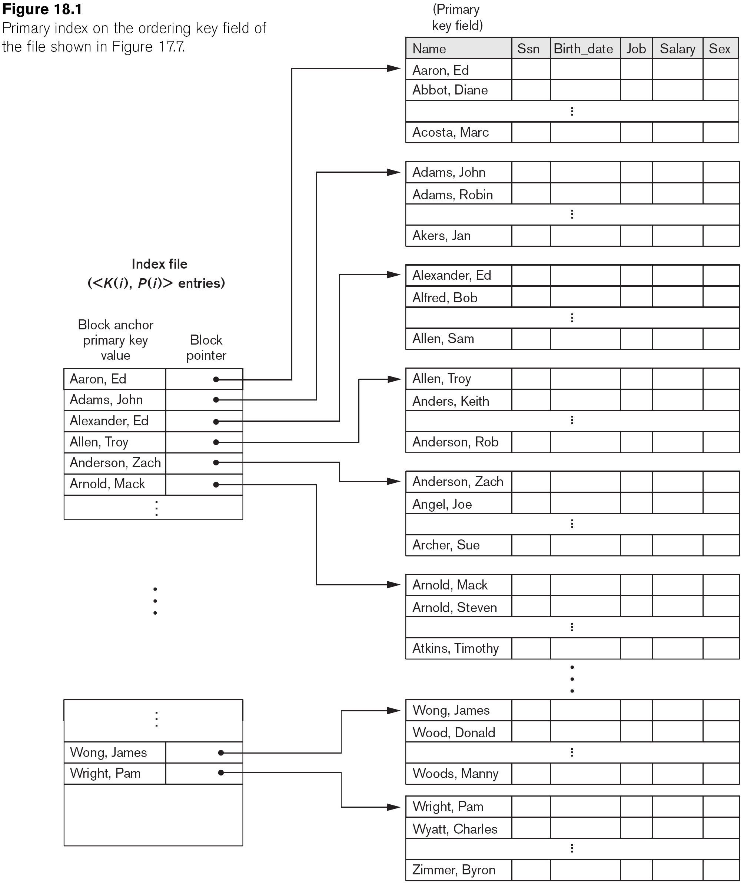
Sample Primary Index

Slide 6
Pop Question
We have an ordered file with r = 30000 records stored on a disk with block size B = 1024 bytes. File records are of fixed size and are unspanned, with record length R = 100 bytes.
What is the blocking factor of the file?
Number of blocks needed for the file?
Cost of Binary search?
Ordering field = 9 bytes. Block pointer = 6 bytes. Blocking factor of the index?
Number of blocks for the index file?
Cost of binary search on the index file?

Slide 7
Pop Question -- Answers
We have an ordered file with r = 30000 records stored on a disk with block size B = 1024 bytes. File records are of fixed size and are unspanned, with record length R = 100 bytes.
What is the blocking factor of the file? Floor(1024/100) = 10 rec/block
Number of blocks needed for the file? Ceil(30000/10) = 3000 blocks
Cost of Binary search? Ceil(log₂3000) = 12
Ordering field = 9 bytes. Block pointer = 6 bytes. Blocking factor of the index? Floor(1024/15) = 68 entries/blo
Number of blocks for the index file? Ceil(3000/68) = 45 blocks
Cost of binary search on the index file? Ceil(log₂45) = 6

Slide 8
Single-Level Indexes
Clustering Index
Defined on an ordered data file
The data file is ordered on a non-key field unlike primary index.
Includes one index entry for each distinct value of the field.
the index entry points to the first data block that contains records with that field value.
It is another example of nondense index.

Slide 9
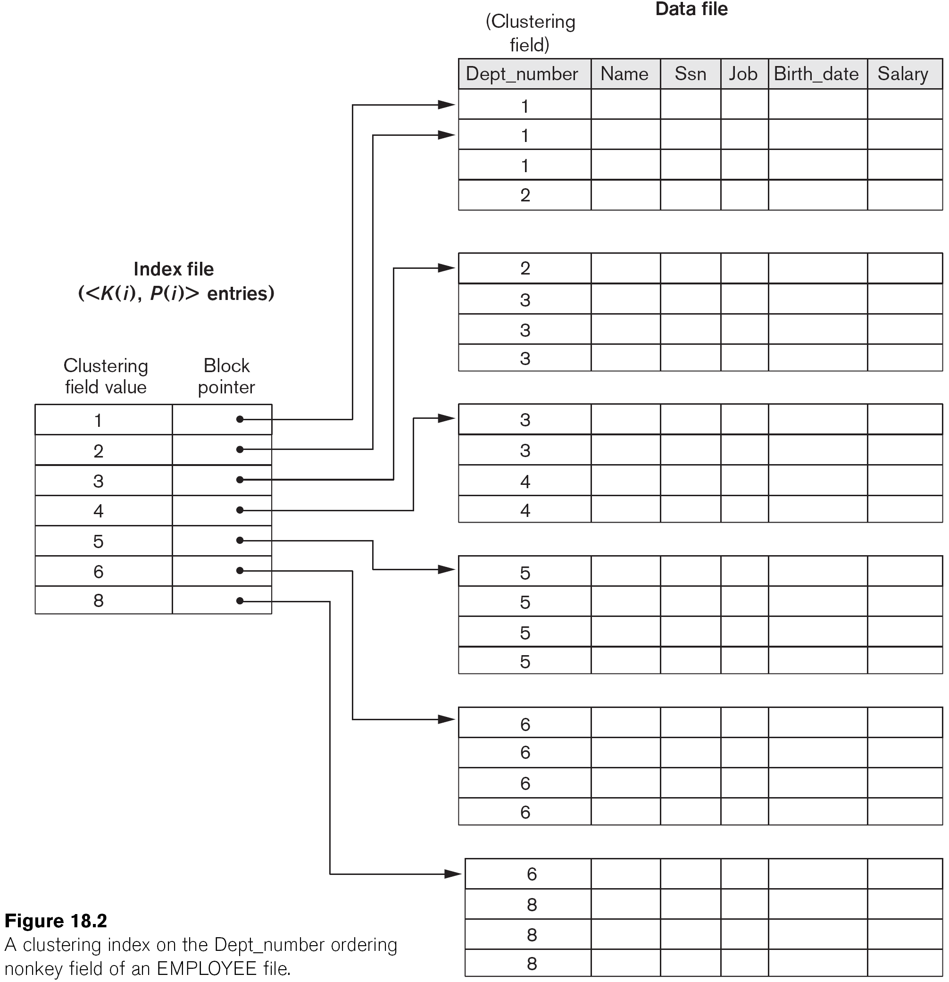
Sample Clustering Index

Slide 10
Single-Level Indexes
Secondary Index
It is an alternative means of accessing (other than primary index).
Can be created on any file organization (ordered, unordered or hashed).
Can be created on any field, key (unique values) or non-key (duplicate values).
Many secondary indexes can be created for a file.
Only one primary index possible for a file.
May have to be a dense index as data file records not ordered in indexing field.

Slide 11
Sample Secondary Index --on Key Field
Indexing Field (Secondary Key)
Index Field Value | Block pointer
1
2
3
6
 |  | 13
 |  | 12
 |  | 6
 |  | 10
 |  | 2
 |  | 14
8
10
12
13
 |  | 1
 |  | 3
 |  | 8
…….

Slide 12
Sample Secondary Index --on NonKey
Indexing Field (Secondary Key)
Index Field Value | Block pointer
1
2
3
6
Blocks of Record pointers
 |  | 13
 |  | 12
 |  | 6
…….
 |  | 10
 |  | 2
 |  | 14
8
10
12
13
 |  | 2
 |  | 3
 |  | 8

Slide 13
Pop Question
We have an ordered file with r = 30000 records stored on a disk with block size B = 1024 bytes. File records are of fixed size and are unspanned, with record length R = 100 bytes.
What is the blocking factor of the file? ---- 10
Number of blocks needed for the file? --- 3000
Cost of search on the non-ordering key?
Index field = 9 bytes. Block pointer = 6 bytes. Blocking factor of the a secondary index?
Number of blocks for the index file?
Cost of binary search on the index file?

Slide 14
Pop Question
We have an ordered file with r = 30000 records stored on a disk with block size B = 1024 bytes. File records are of fixed size and are unspanned, with record length R = 100 bytes.
What is the blocking factor of the file? ---- 10
Number of blocks needed for the file? --- 3000
Cost of search on the non-ordering key? b/2 = 3000/2 = 1500
Index field = 9 bytes. Block pointer = 6 bytes. Blocking factor of the a secondary index? Will still be the same Floor(1024/15)
Number of blocks for the index file? Ceil(30000/68) = 442
Cost of binary search on the index file? Ceil(Log₂442) = 9

Slide 15
Summary of Single-Level Indexes

Slide 16
Multi-Level Indexes
Since a single-level index is an ordered file, we can create a primary index to the index itself;
The original index file is called the first-level index and the index to the index is called the second-level index.
Can repeat to create a third, fourth, ..., until all entries fit in one disk block
A multi-level index can be created for any type of first-level index (primary, secondary, clustering) as long as the first-level index consists of more than one disk block

Slide 17
A two level Primary Index

Slide 18
Constructing a Multi-Level Index
Fan-out (fo) factor → index blocking factor
Divides the search space into n-ways (n == fan-out factor)
Now searching in a multi-level index takes Log_{fo}indexblocks
Significantly smaller than the cost of binary search.

Slide 19
Constructing a Multi-Level Index
If the first level contains r1 entries.
Fanout fo = index blocking factor
First needs Ceil(r1/fo) blocks.
#index entries for second level r2 = Ceil(r1/fo)
#index entries for third level r3 = Ceil(r2/fo)
…….
Continues until all the entries of the index level not fit in a block.
Approximately #levels = Ceil(Log_{fo}r1)

Slide 20
Pop Question
We have an ordered file with r = 30000 records stored on a disk with block size B = 1024 bytes. File records are of fixed size and are unspanned, with record length R = 100 bytes.
What is the blocking factor of the file? ---- 10
Number of blocks needed for the file? --- 3000
Cost of search on the non-ordering key? b/2 = 3000/2 = 1500
Index field = 9 bytes. Block pointer = 6 bytes. Blocking factor of the a secondary index? Will still be the same Floor(1024/15)
Number of blocks for the index file? Ceil(30000/68) = 442
How many levels for a multi-level index?

Slide 21
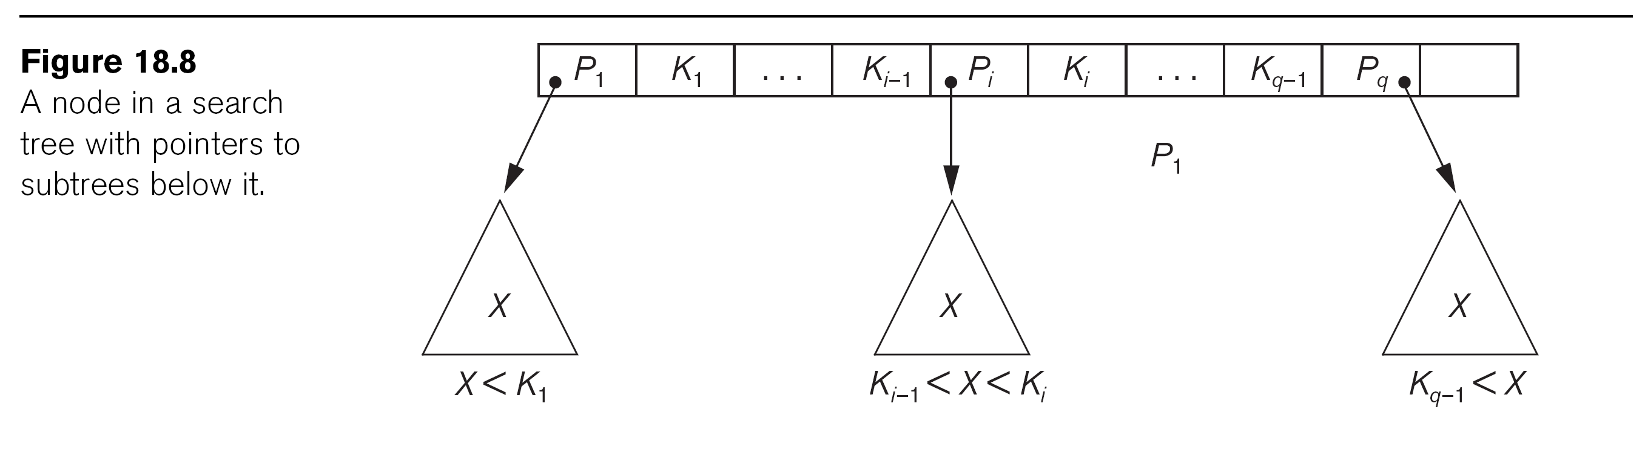
Dynamic Multi-level Indexing

Slide 22
B+ -Tree
The index file is organized as a B+ tree
Height-balanced
Nodes are blocks of index keys and pointers
Order P: Max # of pointers fits in a node
Nodes are at least 50% full
Support efficient updates

Slide 23
B+ -Tree
P = 4
100
Index
file
30
120
150
180
3
5
30
31
35
100
101
110
120
122
130
150
151
156
180
182
200
Point to data records/blocks
Material adapted from Dr John Ortiz

Slide 24
B+ -Tree- Internal nodes
p₀
a₁
…
a_{i}
p_{i}
a_{i+1}
…
a_{k}
p_{k}
key < a₁
…
a_{i} <= key < a_{i+1}
…
key >= a_{k}
The root must have k ≥ 2 pointers
Others must have k ≥ ⎡P/2⎤ pointers, where P is the order of the B+ tree
Root is an exception.
Must have k keys and k+1 pointers
Keys are sorted
Material adapted from Dr John Ortiz

Slide 25
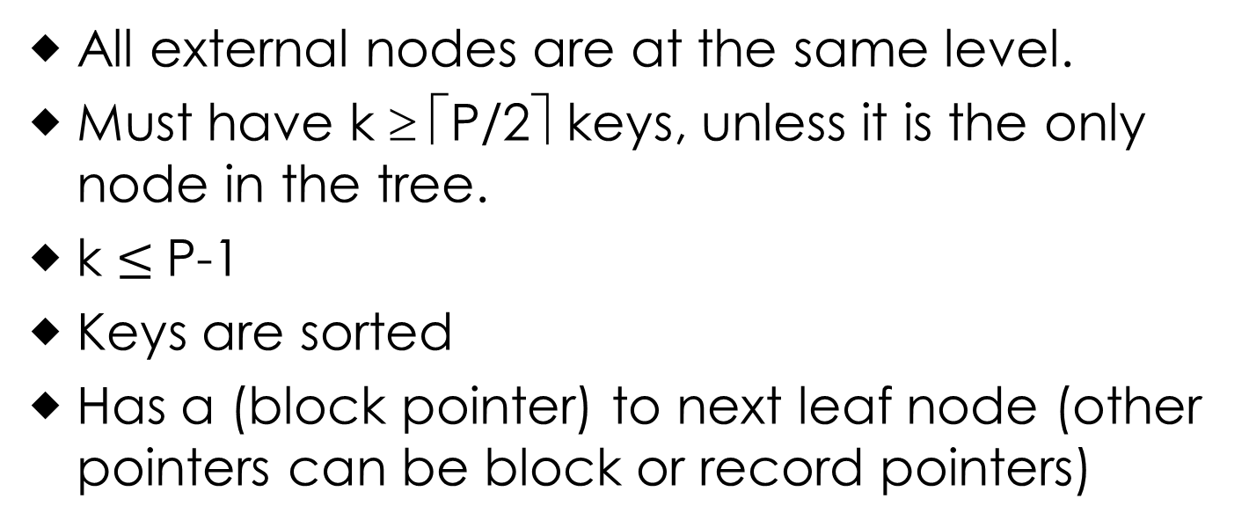
B+ -Tree- Leaf nodes
a₁
pr₁
…
a_{i}
pr_{i}
…
a_{k}
pr_{k}
_{NL}
to next
Leaf node
to data records
All external nodes are at the same level.
Must have k ≥ ⎡P/2⎤ keys, unless it is the only node in the tree.
k $≤$P-1
Keys are sorted
Has a (block pointer) to next leaf node (other pointers can be block or record pointers)
Material adapted from Dr John Ortiz

Slide 26
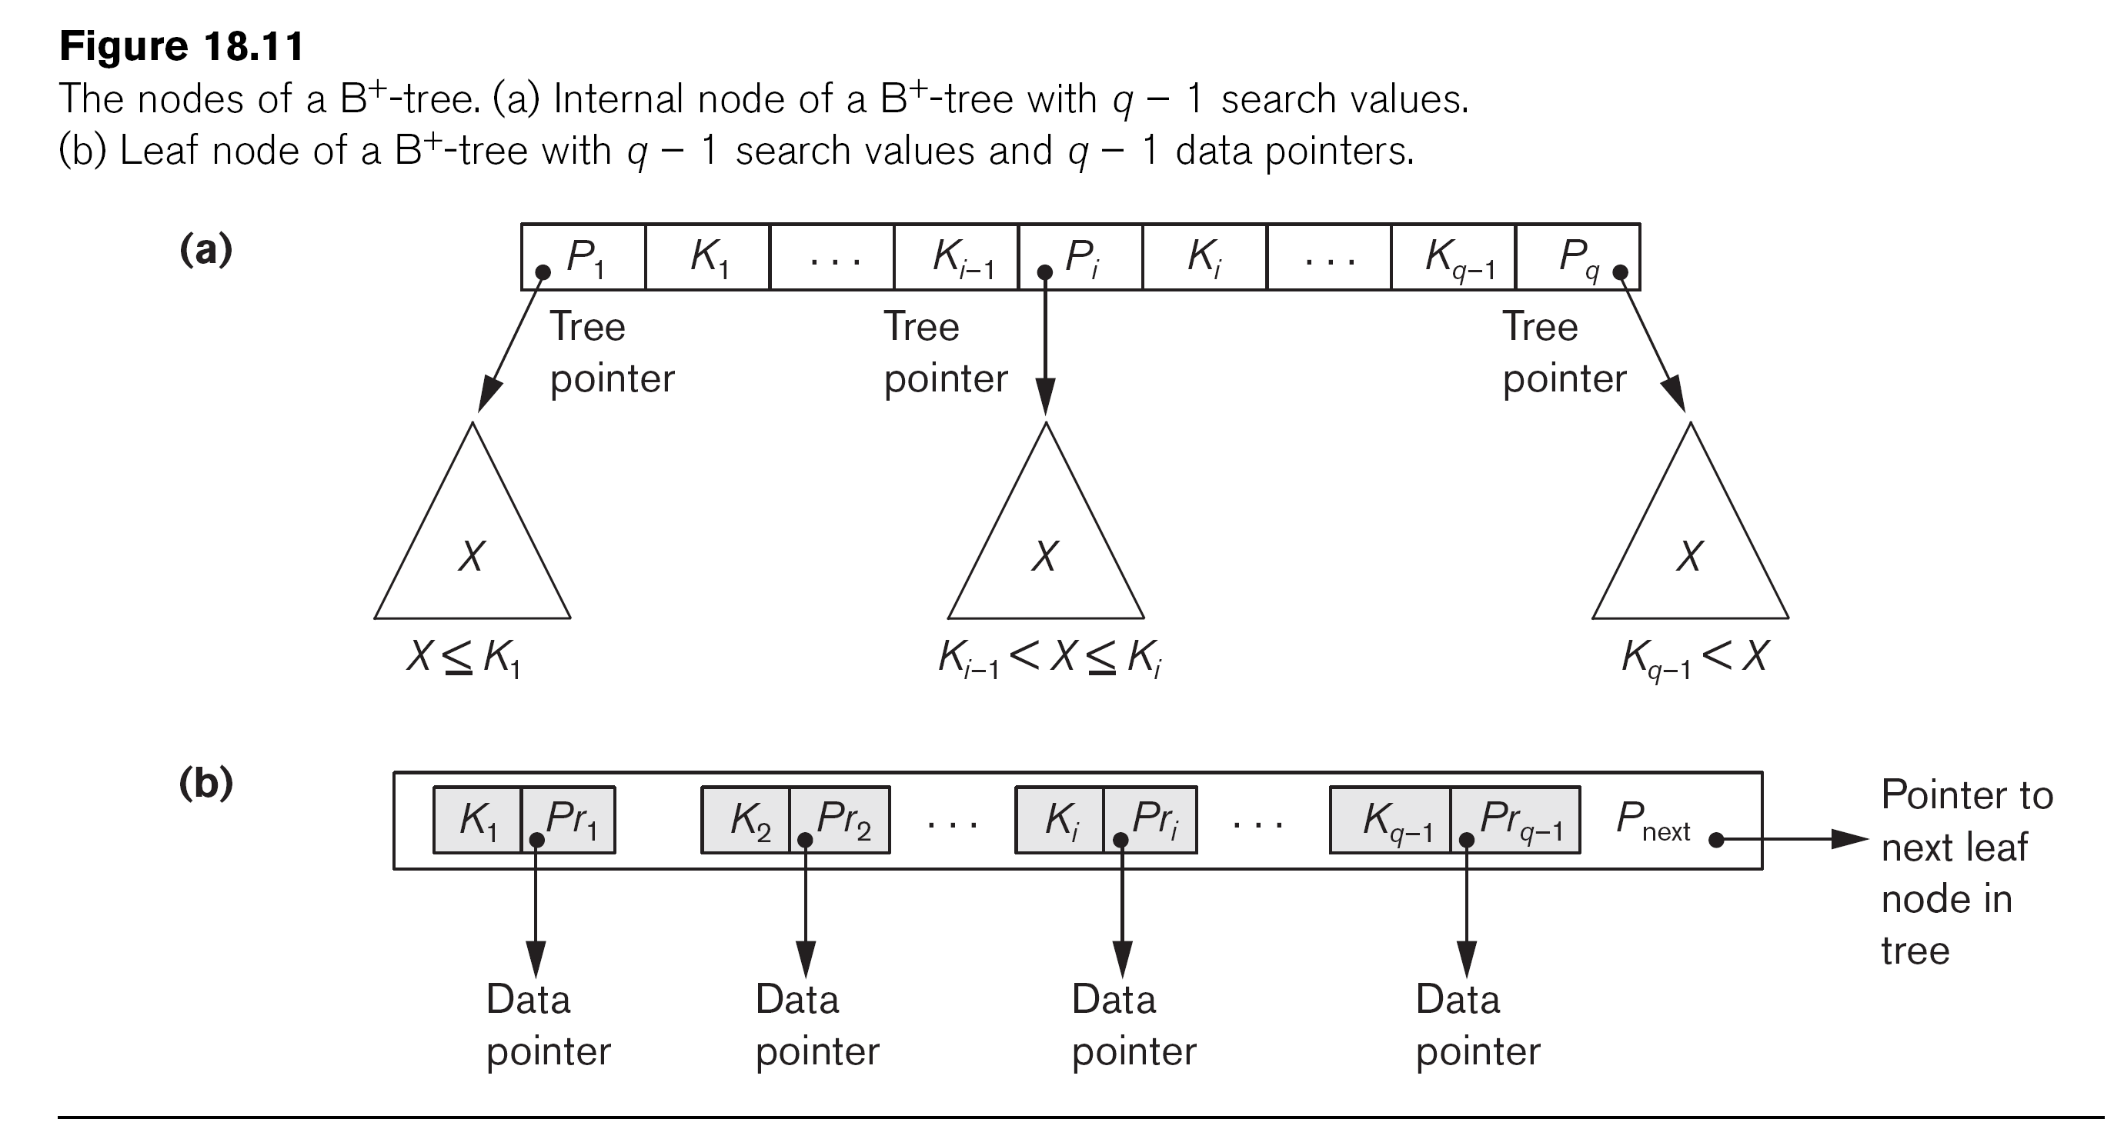
A B+ -Tree Node

Slide 27
Searching in B+ -Tree
Searching just like in a binary search tree
Starts at the root, works down to the leaf level
Does a comparison of the search value and the current “separation value”, goes left or right

Slide 28
Inserting in a B+ -Tree
A search is first performed, using the value to be added
After the search is completed, the location for the new value is known

Slide 29
Inserting in a B+ -Tree
If the tree is empty, add to the root
Once the root is full, split the data into 2 leaves, using the root to hold keys and pointers
If adding an element will overload a leaf, take the median and split it

Slide 30
Example on Insert Operation in B+
Root
Insert 18; Order=5
Where does it go?
13
17
24
30
2
3
5
13
14
15
16
17
20
22
24
27
29
30
34
38
39

Slide 31
Example on Insert Operation in B+
Root
Insert 18; Order=5
Where does it go?
13
17
24
30
2
3
5
13
14
15
16
17
18
20
22
24
27
29
30
34
38
39

Slide 32
Example on Insert Operation in B+
Root
Insert 8; Order=5
Where does it go?
13
17
24
30
2
3
5
13
18
20
22
24
27
29
30
33
38
39
14
15
16
17

Slide 33
Example on Insert Operation in B+
Root
Insert 8; Order=5
Where does it go?
Leaf already full; Need to split
13
17
24
30
2
3
5
13
14
15
16
17
18
20
22
24
27
29
30
33
38
39

Slide 34
Example on Insert Operation in B+
Insert 8; Order=5
Root
Split along the median
13
17
24
30
14
15
16
17
2
3
5
18
20
22
24
27
29
30
33
38
39
8
13
New Leaf

Slide 35
Example on Insert Operation in B+
Insert 8; Order=5
Root
Send the Median (5) to level above
13
17
24
30
14
15
16
17
2
3
5
18
20
22
24
27
29
30
33
38
39
8
13
New Leaf

Slide 36
Example on Insert Operation in B+
Insert 8; Order=5
Root
Send the Median (5) to level above
13
17
24
30
2
3
5
15
16
18
20
22
24
27
29
30
33
38
39
8
13
14
17

Slide 37
Example on Insert Operation in B+
Insert 8; Order=5
Root
Send the Median (5) to level above;
Also full; Need to split
13
17
24
30
2
3
18
20
22
24
27
29
30
33
38
39
5
8
13
14
15
16
17

Slide 38
Example on Insert Operation in B+
Insert 8; Order=5
Root
Split along the Median (17);
Send Median a level above;
New root!
13
17
24
30
Median (5)
Added here
2
3
5
8
13
14
15
16
17
18
20
22
24
27
29
30
33
38
39

Slide 39
Example on Insert Operation in B+
Insert 8; Order=5
Split along the Median (17);
Send Median a level above;
New root!
Root
17
5
13
24
30
2
3
5
8
13
14
15
16
17
18
20
22
24
27
29
30
33
38
39

Slide 40
Example on Insert Operation in B+
Insert 8; Order=5
17 is the new Root
17
5
13
24
30
2
3
5
8
13
14
15
16
17
18
20
22
24
27
29
30
33
38
39

Slide 41
Deletion in B+ -Tree
Find the key to be deleted
Remove (search-key value, pointer) from the leaf node
If the node has too few entries (underflow) due to the removal
We have two options: (a) Merge siblings or (b) Redistribution
Material adapted from Silberchatz, Korth and Sudarshan

Slide 42
Deletion in B+ -Tree – Merging Siblings
Insert all the search-key values in the two nodes into a single node (the one on the left or right).
Depending on left of right, the algorithm will vary slightly.
Delete the other node.
Delete the pair (K_{i–1}, P_{i}), where P_{i} is the pointer to the deleted node from its parent.
Proceed to upper levels recursively as necessary.
Material adapted from Silberchatz, Korth and Sudarshan

Slide 43
Deletion in B+ -Tree – Redistribution Siblings
After removal, the entries in the node and a sibling do not fit into a single node, then redistribute pointers:
Redistribute the pointers between the node and a sibling such that both have more than the minimum number of entries.
Update the corresponding search-key value in the parent of the node.
Material adapted from Silberchatz, Korth and Sudarshan

Slide 44
Deletion in B+ -Tree Contd…
The node deletions may cascade upwards till a node which has ⎡n/2⎤ or more pointers is found.
If the root node has only one pointer after deletion, it is deleted and the sole child becomes the root.

Slide 45
Example on Deletion operation in B+ -Tree
22
Order = 4
5
10
16
30
2
5
8
10
15
16
18
20
22
29
30
33
38

Slide 46
Example on Deletion operation in B+ -Tree
22
Delete 38
5
10
16
30
2
5
8
10
15
16
18
20
22
29
30
33
38

Slide 47
Example on Deletion operation in B+ -Tree
22
Delete 38
5
10
16
30
Underflow
2
5
8
10
15
16
18
20
22
29
30
33

Slide 48
Example on Deletion operation in B+ -Tree
22
Delete 38
5
10
16
30
Merging
2
5
8
10
15
16
18
20
22
29
30
33

Slide 49
Example on Deletion operation in B+ -Tree
22
Delete 38
5
10
16
30
Merging
2
5
8
10
15
16
18
20
22
29
30
33

Slide 50
Example on Deletion operation in B+ -Tree
22
Delete 38
5
10
16
30
Delete these
2
5
8
10
15
16
18
20
22
29
30
33

Slide 51
Example on Deletion operation in B+ -Tree
22
Delete 38
5
10
16
30
Underflow
2
5
8
10
15
16
18
20
22
29
30
33

Slide 52
Example on Deletion operation in B+ -Tree
22
Delete 38
5
10
16
30
Cannot merge with this node
2
5
8
10
15
16
18
20
22
29
30
33

Slide 53
Example on Deletion operation in B+ -Tree
22
Delete 38
5
10
16
30
Thus, we will re-distribute
2
5
8
10
15
16
18
20
22
29
30
33

Slide 54
Example on Deletion operation in B+ -Tree
22
Delete 38
5
10
16
30
16 is removed from here.
It goes to root
2
5
8
10
15
16
18
20
22
29
30
33

Slide 55
Example on Deletion operation in B+ -Tree
22
Delete 38
5
10
16
30
22 from root Comes here along with pointer to leaf containing 18, 20, 22
2
5
8
10
15
16
18
20
22
29
30
33

Slide 56
Example on Deletion operation in B+ -Tree
16
Delete 38
5
10
22
Other pointers are shifted
2
5
8
10
15
16
18
20
22
29
30
33

Slide 57
Example on Deletion operation in B+ -Tree
16
Delete 33, 30
5
10
22
2
5
8
10
15
16
18
20
22
29
30
33

Slide 58
Example on Deletion operation in B+ -Tree
16
Delete 33, 30
5
10
22
No issues in deleting 33
2
5
8
10
15
16
18
20
22
29
30
33

Slide 59
Example on Deletion operation in B+ -Tree
16
Delete 30
5
10
22
Now this is underflow
2
5
8
10
15
16
18
20
22
29
30

Slide 60
Example on Deletion operation in B+ -Tree
16
Delete 30
5
10
22
Merge or Redistribute?
2
5
8
10
15
16
18
20
22
29

Slide 61
Example on Deletion operation in B+ -Tree
16
Delete 30
5
10
22
22 moves here
2
5
8
10
15
16
18
20
22
29

Slide 62
Example on Deletion operation in B+ -Tree
Final result after deleting 30
16
5
10
20
20 replaces 22 in the parent
2
5
8
10
15
16
18
20
22
29

Slide 63
Example on Deletion operation in B+ -Tree
16
Delete 18
5
10
20
2
5
8
10
15
16
18
20
22
29

Slide 64
Example on Deletion operation in B+ -Tree
16
Delete 18
5
10
20
Underflow, merge with sibling
2
5
8
10
15
16
18
20
22
29

Slide 65
Example on Deletion operation in B+ -Tree
16
Delete 18
5
10
20
Underflow, merge with sibling
2
5
8
10
15
16
20
22
29

Slide 66
Example on Deletion operation in B+ -Tree
16
Delete 18
5
10
20
Underflow, merge with sibling
2
5
8
10
15
16
20
22
29

Slide 67
Example on Deletion operation in B+ -Tree
16
Delete 18
5
10
16
Move pointers. And delete the root as it has only one child
2
5
8
10
15
16
20
22
29

Slide 68
Example on Deletion operation in B+ -Tree
Final result after deleting 18
5
10
16
2
5
8
10
15
16
20
22
29

Slide 69
Indexing Strings in B+ - Tree
Variable length strings as keys
Variable fanout
Use space utilization as criterion for splitting, not number of pointers
Prefix compression
Key values at internal nodes can be prefixes of full key
Keep enough characters to distinguish entries in the subtrees separated by the key value
E.g. “Shailaja” and “Shailendra” can be separated by “Shaila”
Keys in leaf node can be compressed by sharing common prefixes
Material adapted from Silberchatz, Korth and Sudarshan

Slide 70
Bulk loading entries in B+ - Tree
Inserting entries one-at-a-time into a B⁺-tree requires ≥ 1 IO per entry
can be very inefficient for loading a large number of entries at a time (bulk loading)
Efficient alternative 1:
Sort entries first (using efficient external-memory algorithms)
Insert in sorted order
Insertion will go to existing page (or cause a split).
Much improved IO performance.
Material adapted from Silberchatz, Korth and Sudarshan

Slide 71
Bulk loading entries in B+ - Tree
Efficient alternative 2: Bottom-up B⁺-tree construction
As before sort entries
And then create tree layer-by-layer, starting with leaf level.
Implemented as part of bulk-load utility by most database systems
Material adapted from Silberchatz, Korth and Sudarshan

Slide 72
Non-unique Search Queries in B+ - Tree
Store the key as many times as it appears.
List of tuple pointers with each distinct value of key
Extra code to handle long lists.
Material adapted from Silberchatz, Korth and Sudarshan

Slide 73
Difference between B-Tree and B+ - Tree
In a B-tree, pointers to data records exist at all levels of the tree
In a B+-tree, all pointers to data records exists at the leaf-level nodes

Slide 74
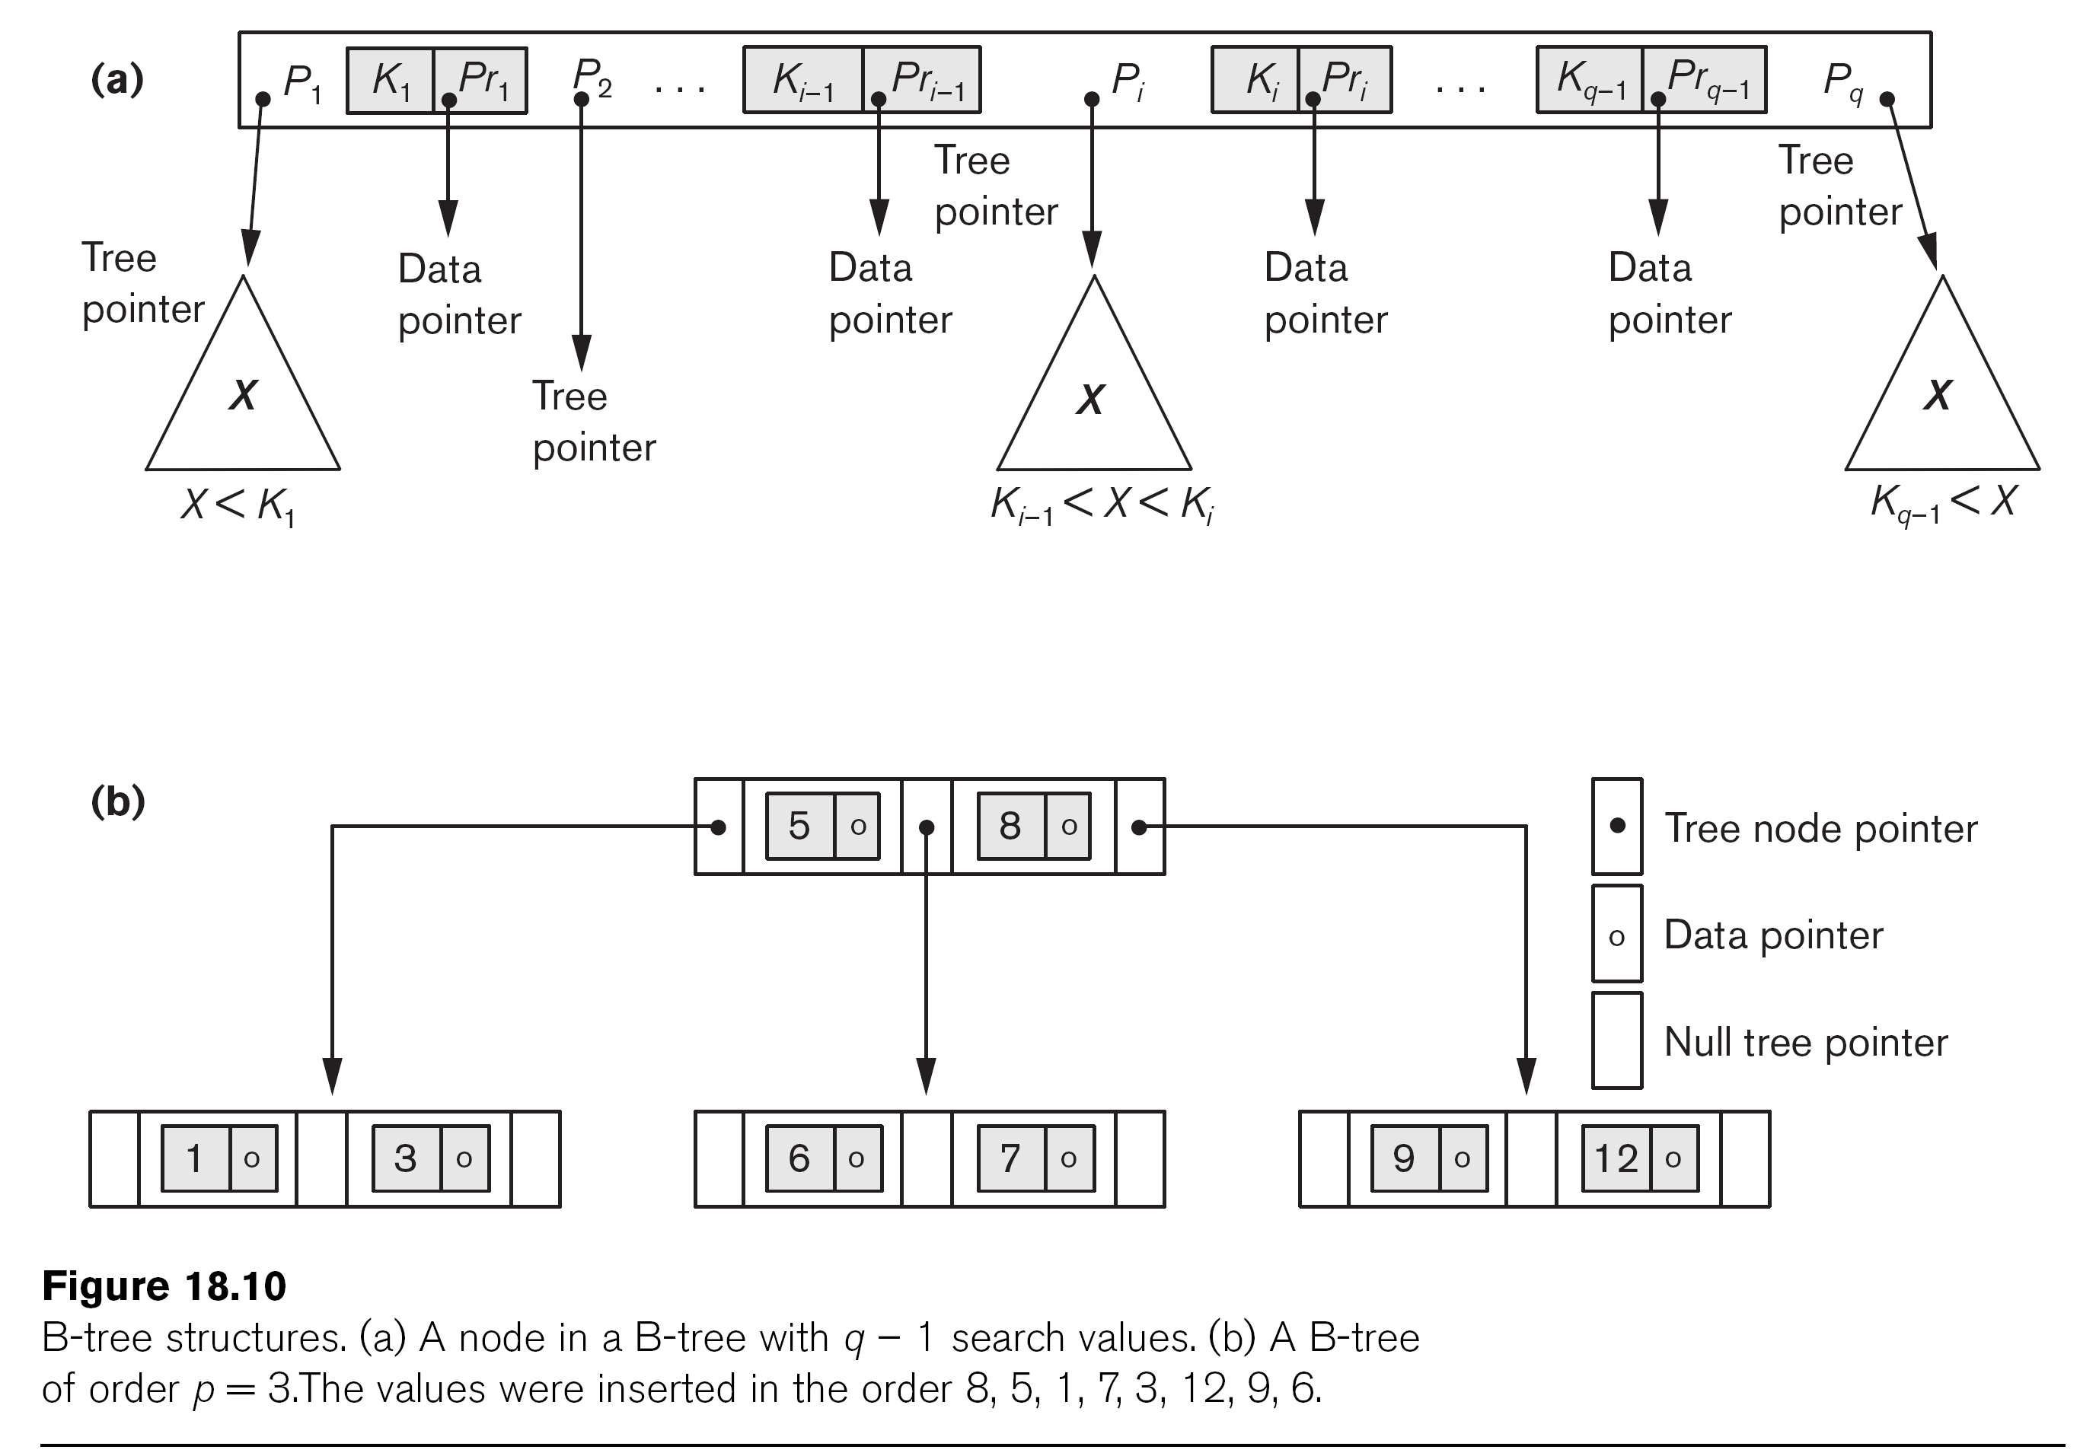
A B-Tree Node

Slide 75
B-Tree Vs B+ - Tree
Advantages of B-Tree indices:
May use less tree nodes than a corresponding B⁺-Tree.
Sometimes possible to find search-key value before reaching leaf node.
Disadvantages of B-Tree indices:
Only small fraction of all search-key values are found early
Non-leaf nodes are larger, so fan-out is reduced. Thus, B-Trees typically have greater depth than corresponding B⁺-Tree
A B+-tree can have less levels (or higher capacity of search values) than the corresponding B-tree
Typically, advantages of B-Trees do not out weigh disadvantages.
Material adapted from Silberchatz, Korth and Sudarshan

